Slide 1
PAYLOAD ANALYSIS
Presentation By: Mainak Purkayastha

Slide 2
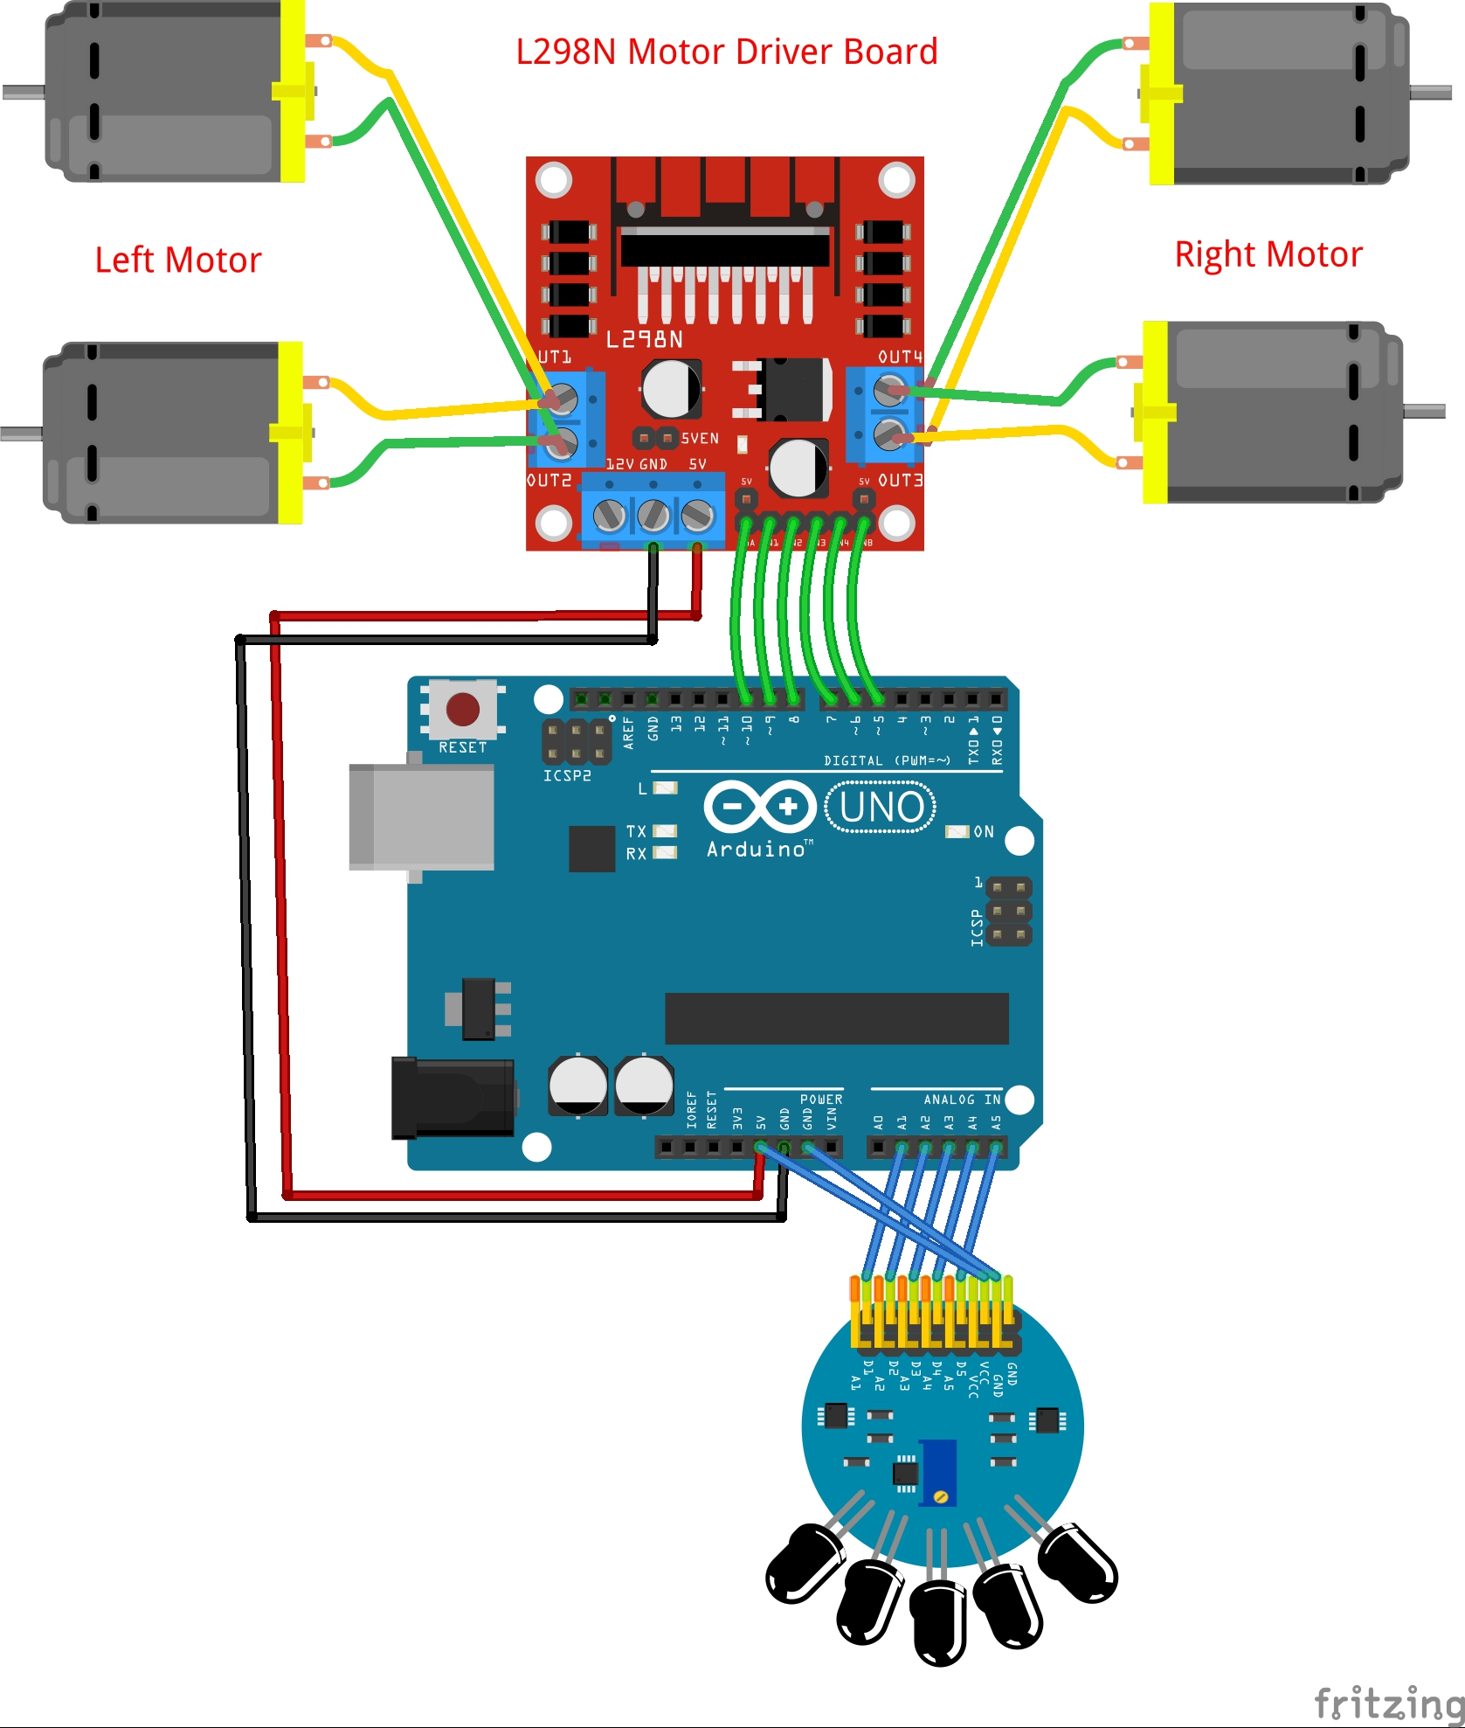
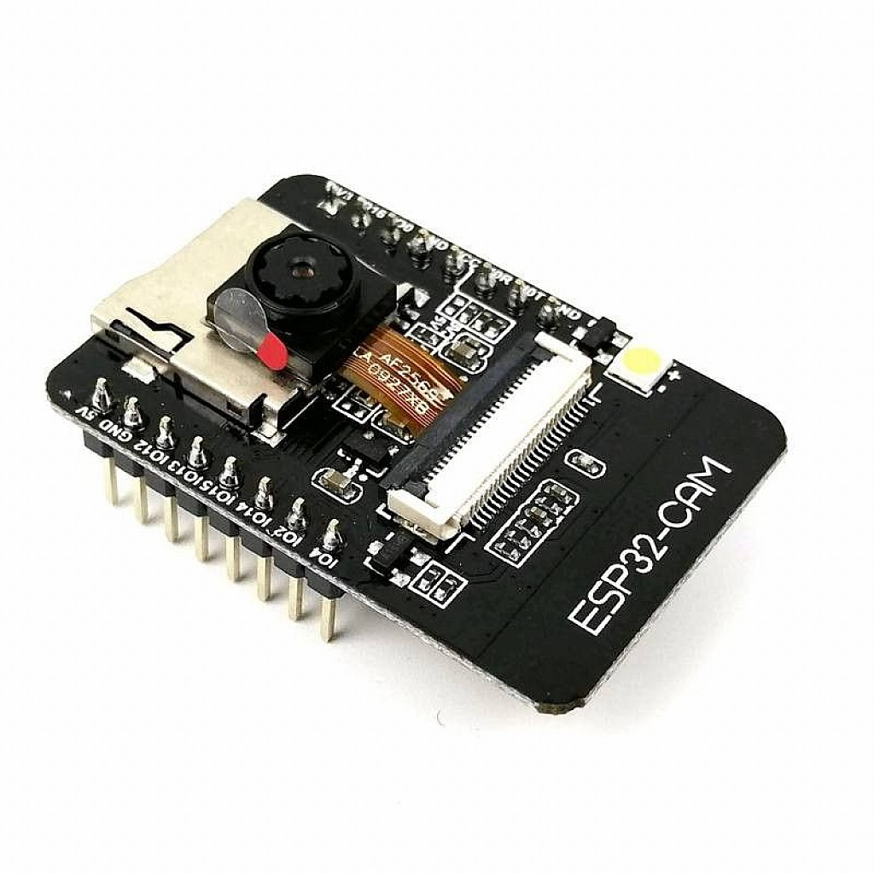
PAYLOAD For Pest Control
ESP32 CAM MODULE

Slide 3
Parts Overview
Parts | Current Drawn | Cost
ESP 32 Cam Module | 180mA without flash 310mA with flash | ₹740
MG90s (Servo Motor) | 6 mA Idle Current 270mA lifting Current | ₹340
5-IR Sensor Array | 100mA | ₹200
N20 Geared Motor Acrylic Chassis Wheels | 100mA No Load Current 1A Stall Current | ₹1800
L298n Motor Driver | 36mA | ₹153
18650 Li-ion Battery | ---- | ₹190
Zigbee XBEE | 33mA Transmit Current 28mA Receive Current | ₹1500
Arduino Uno | 50mA | ₹560

Slide 4
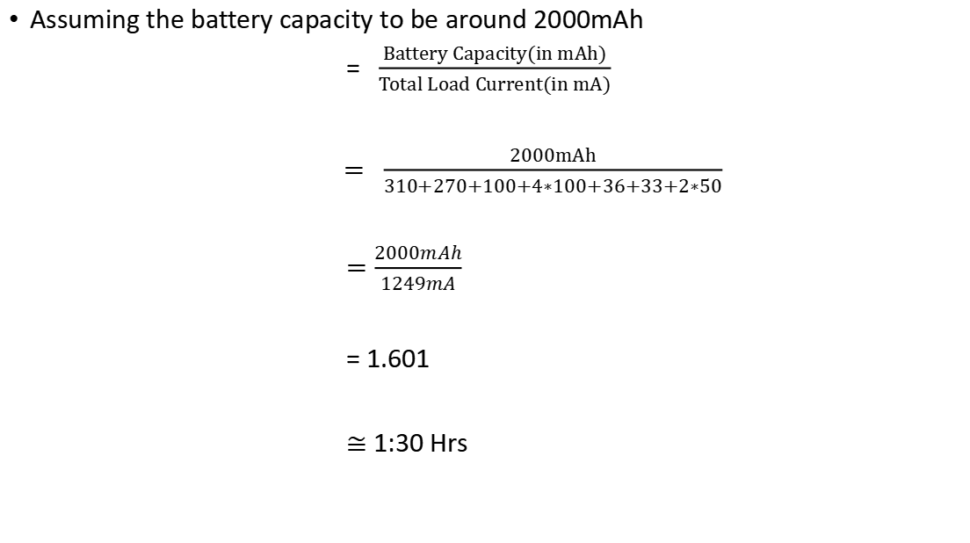
Feasibility
Assuming the battery capacity to be around 2000mAh
$= \frac{Battery Capacity(in mAh)}{Total Load Current(in mA)}$
$= \frac{2000mAh}{310+270+100+4∗100+36+33+2∗50}$
$=\frac{2000mAh}{1249mA}$
= 1.601
$≅$ 1:30 Hrs

Slide 5
For the overall cost of the parts
5-IR sensor array
L298N motor driver
Chassis + N20 motor driver + Wheels
ESP32 cam module
3*18650 Li-ion battery and Charger
All of the above mentioned parts will cost around approximately ₹3563.

